Slide 1
Machine Learning @ Brocade Current Events
Ed Henry, David Meyer, and Armin Wasicek
Winter CTO Forum
14-15 Dec 2016

Slide 2
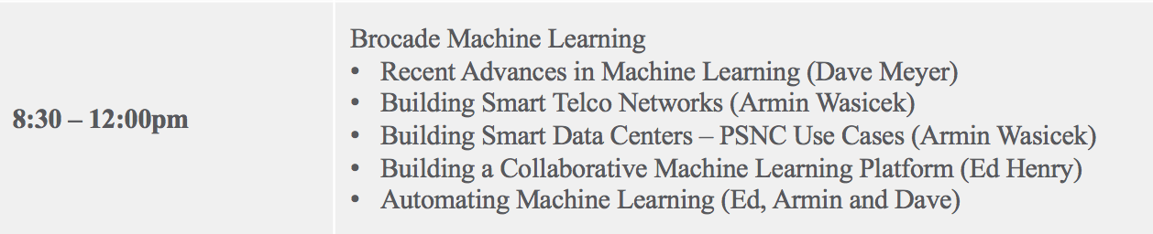
Overall Agenda
Current Events In Machine Learning: Challenges, Opportunities and Realities
45 min, dmm
Building Smart Networks for Telcos
30 min, Armin
Break
15 min
Use Cases For Data Center Machine Learning At PSNC
30 min, Armin
How To Implement A Collaborative Machine Learning Platform
25 min, Ed
Break
15 min
Automating Machine Learning
25 min, Armin, Ed
Discussion
25 min, all

Slide 3
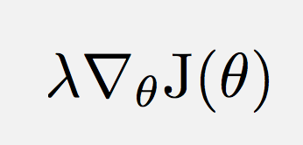
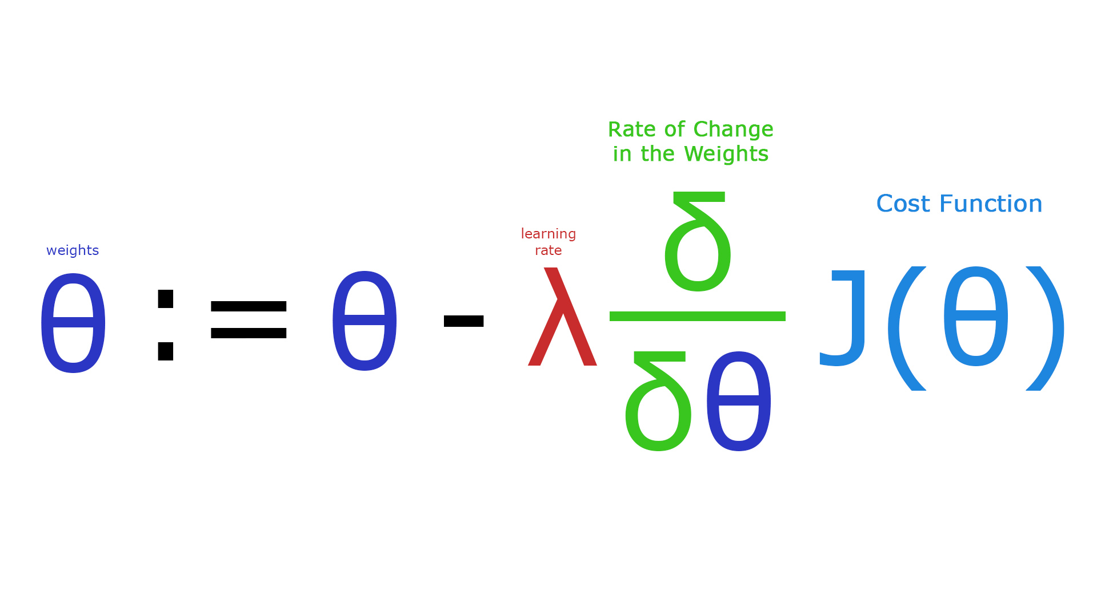
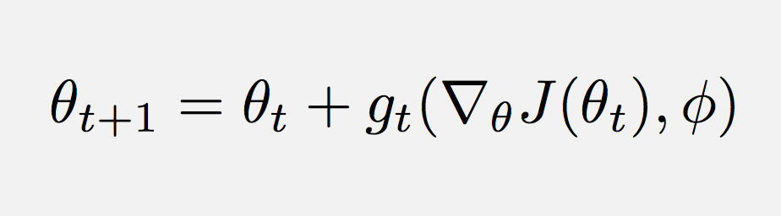
Current Events in ML for Networking Challenges, Opportunities and Realities
Casting algorithm design as a learning problem
http://papers.nips.cc/paper/6461-learning-to-learn-by-gradient-descent-by-gradient-descent.pdf
https://github.com/deepmind/learning-to-learn

Slide 4
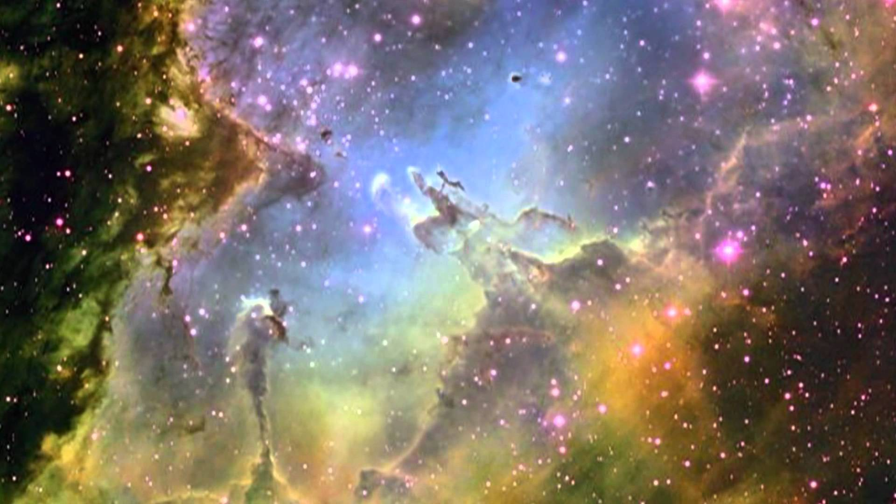
Goals For This Talk
The goals for this talk are to briefly review the
state of the art in Machine Learning as applied to data networking, with particular focus on
What is practical today
What are the challenges¹, and
What are the opportunities
We’ll go easy on the math here, but if you’re interested in that part of all of this
see http://www.1-4-5.net/~dmm/ml for some introductory material.
1 Noting the these challenges are both technological and socio-economic.

Slide 5
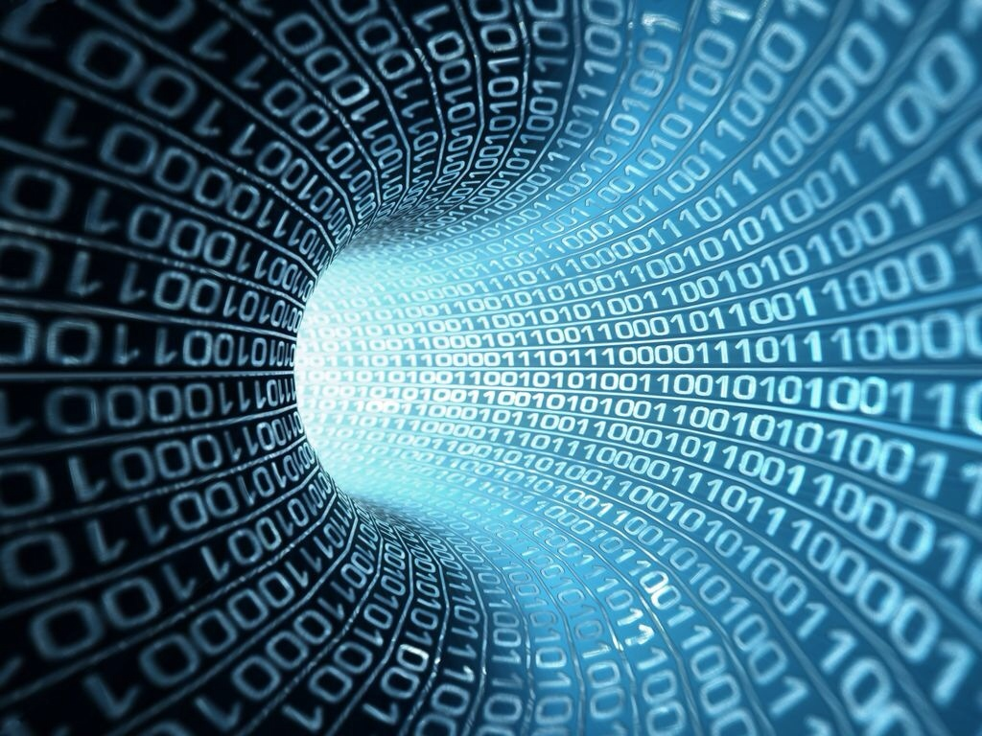
You might be surprised but what is going to drive innovation in the enterprise and in the public cloud is machine learning.
Bill Coughran, Sequoia Capital #‎ONUGSpring16‬

Slide 6
Machine Learning is the way we are going to automate your automation.
Chris Wright, RedHat CTO #RHSummit

Slide 7
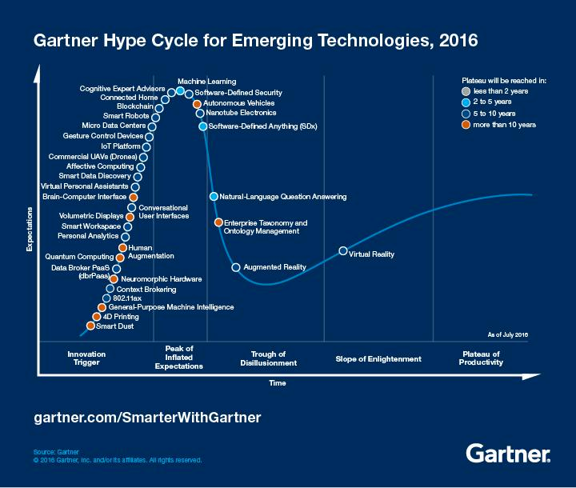
But Be Careful…
You are here (again)
https://en.wikipedia.org/wiki/AI_winter

Slide 8
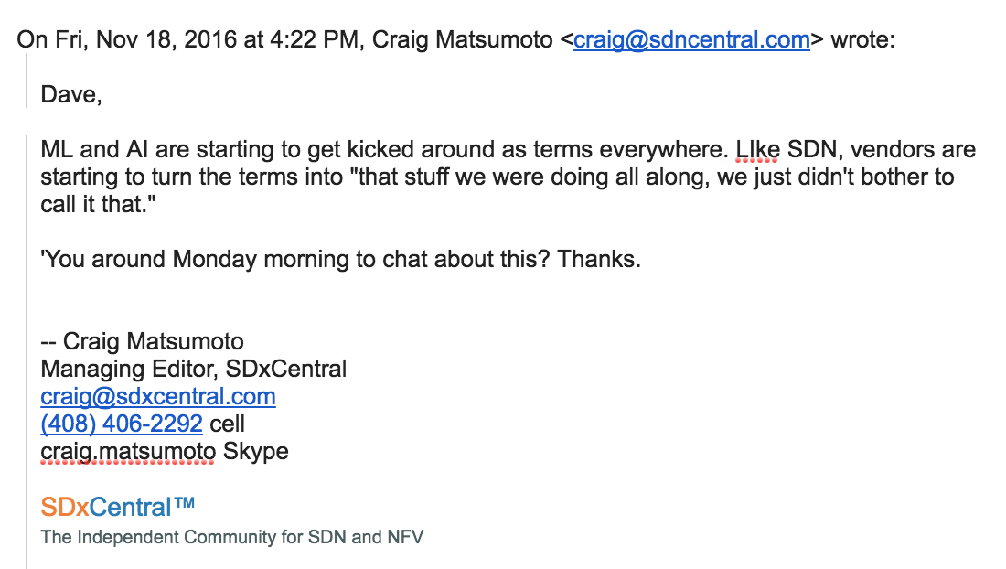
So Beware of Industry Hype

Slide 9
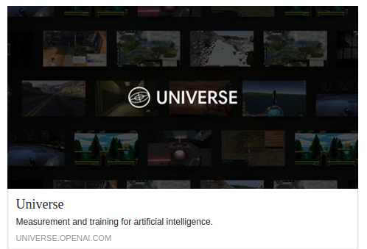
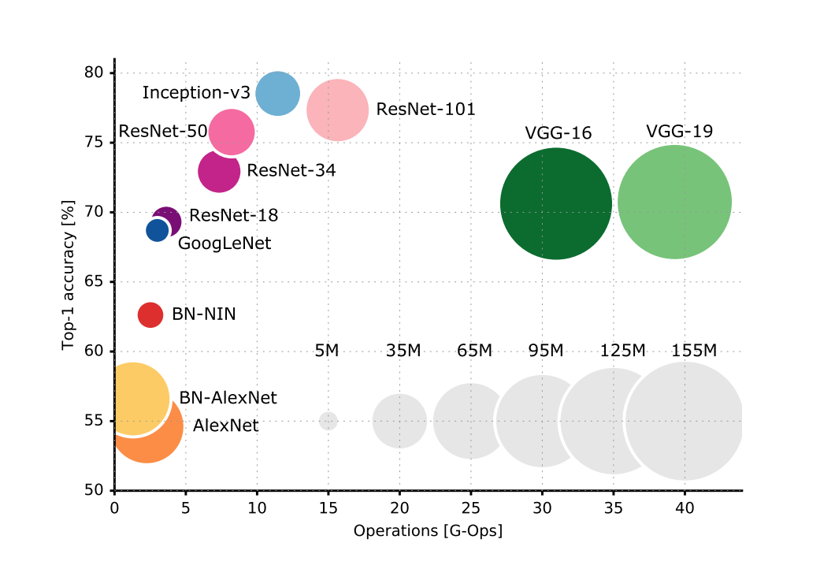
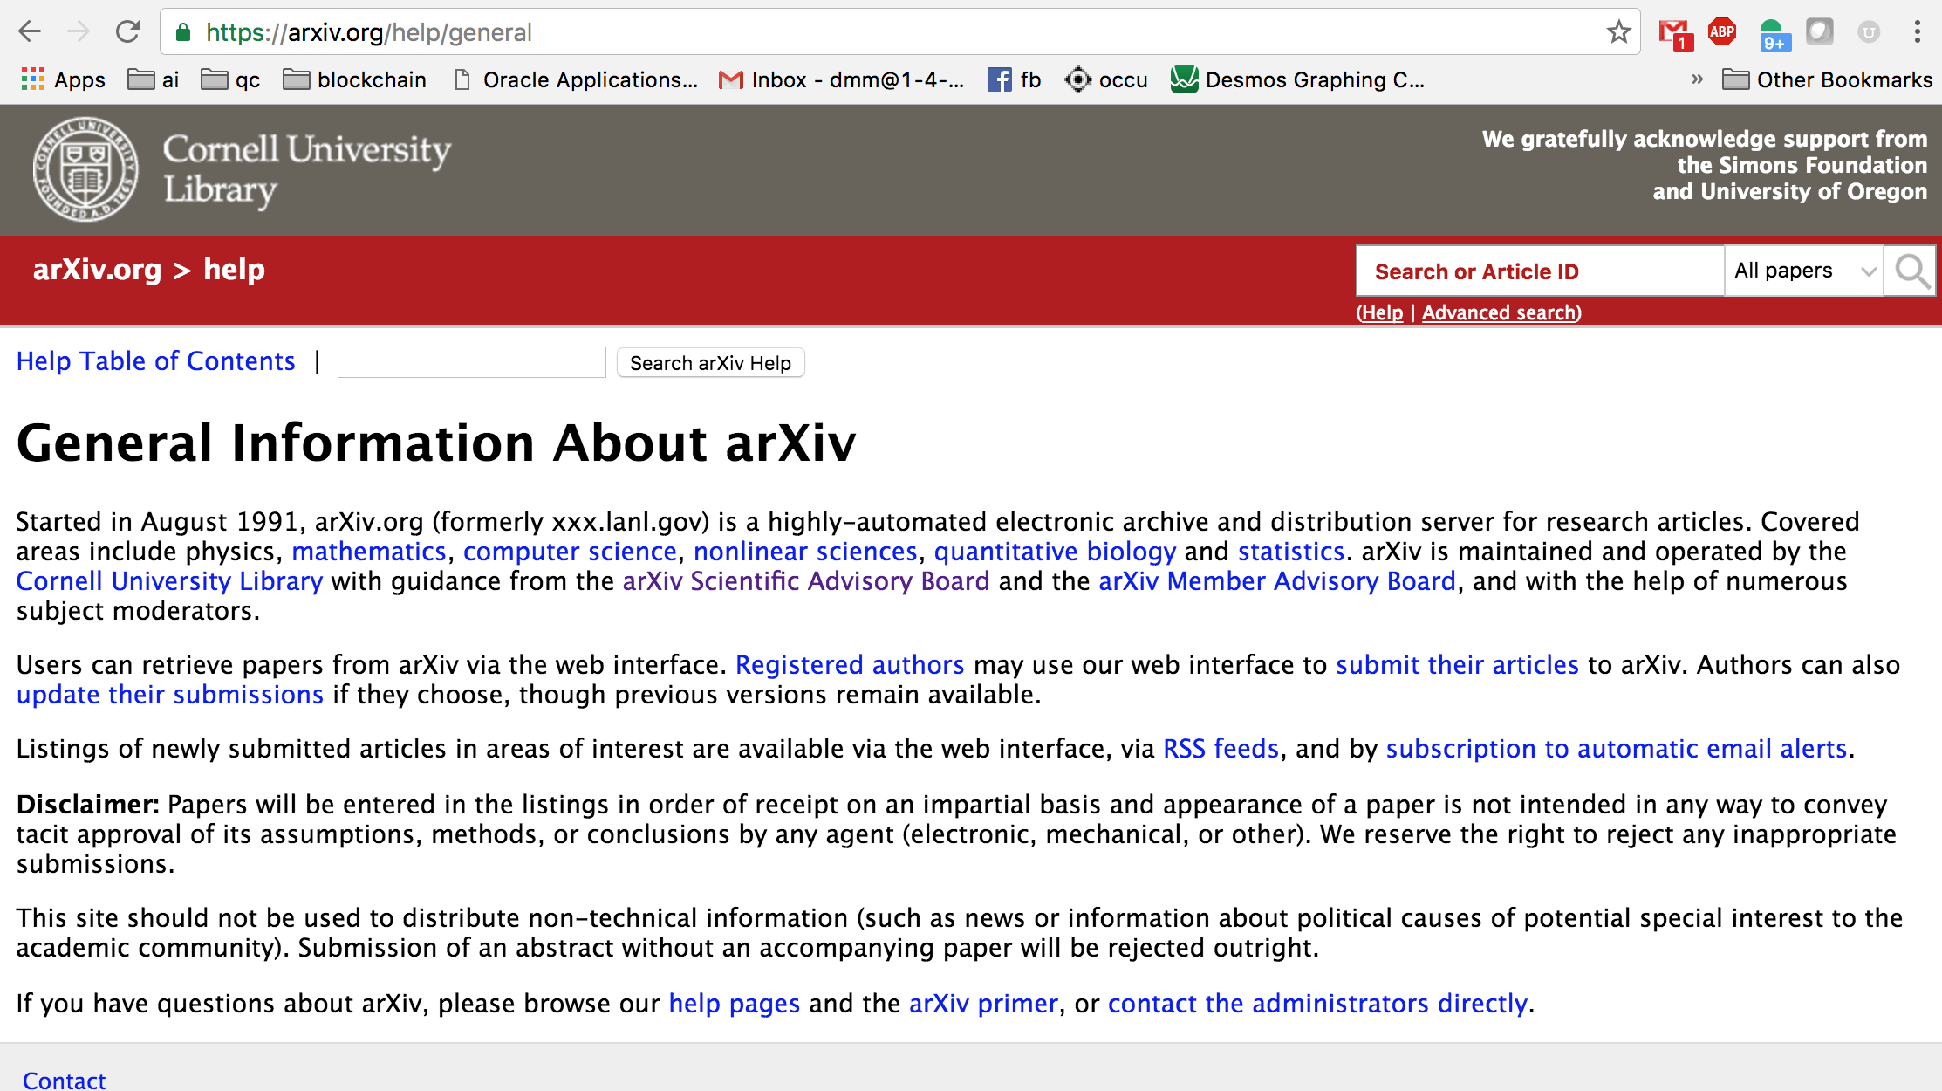
One Other Important Observation
The ML community has a long history of
Open Source
https://www.tensorflow.org, …
Open Data
http://image-net.org, …
Open Models
https://github.com/BVLC/caffe/tree/master/models/bvlc_alexnet, …
Open Science
https://arxiv.org, …
Integrating all of these ideas
http://ai-on.org/
So when there are important breakthroughs in ML, you see
Published descriptions and results, at least on arXiv
Diverse set of open source implementations
Growing communities
https://github.com/robertsdionne/neural-network-papers
https://github.com/kjw0612/awesome-deep-vision

Slide 10
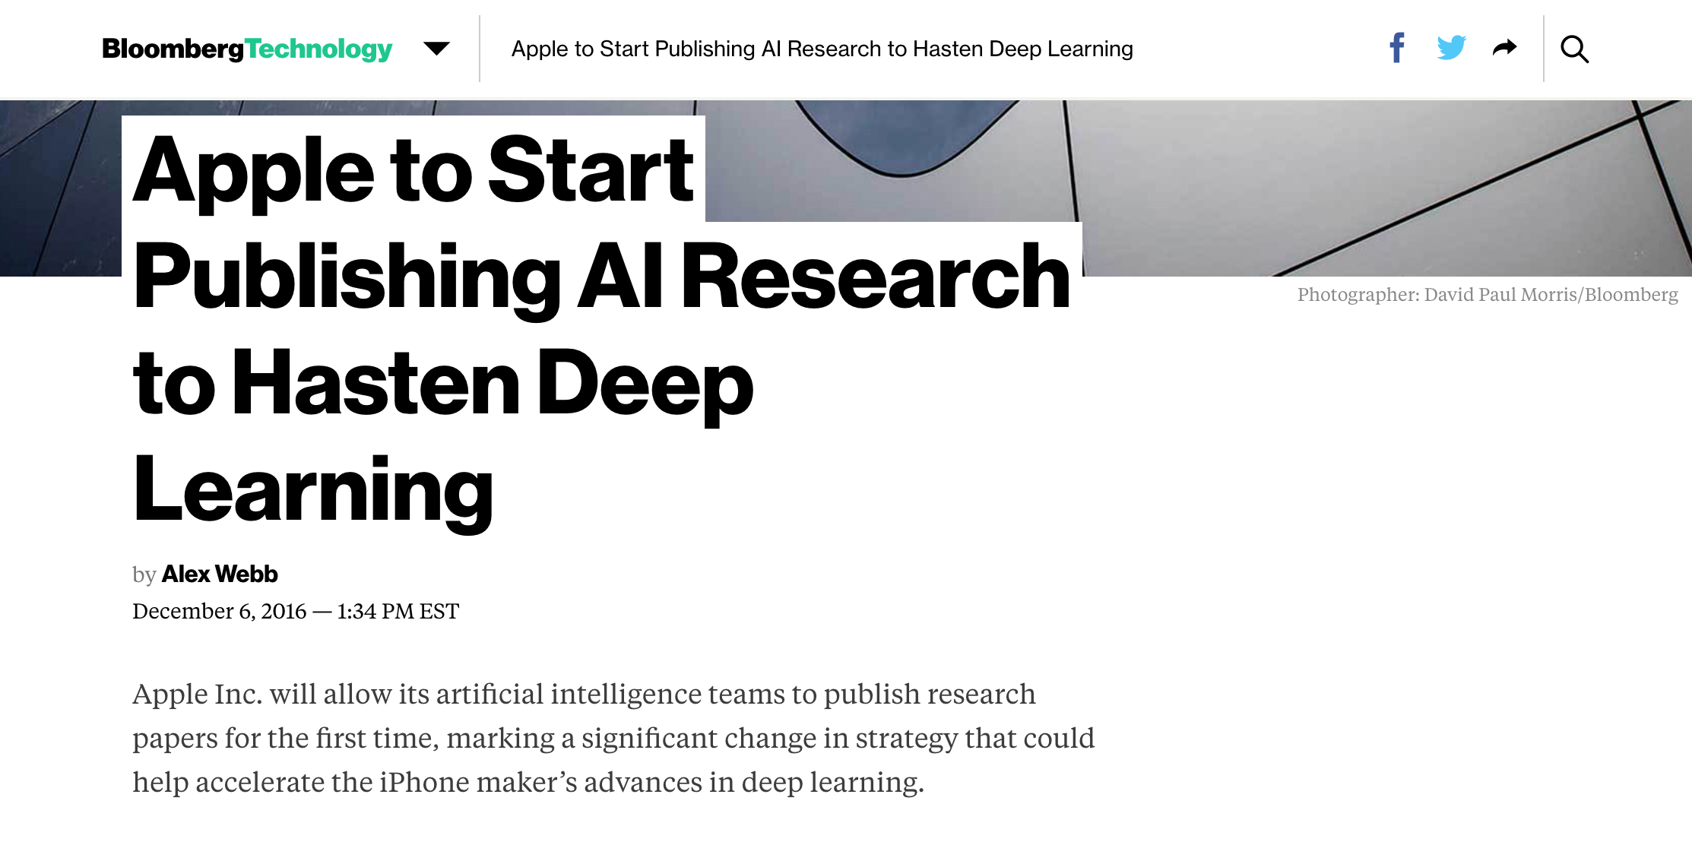
Example: Apple
https://www.bloomberg.com/news/articles/2016-12-06/apple-to-start-publishing-ai-research-to-hasten-deep-learning

Slide 11
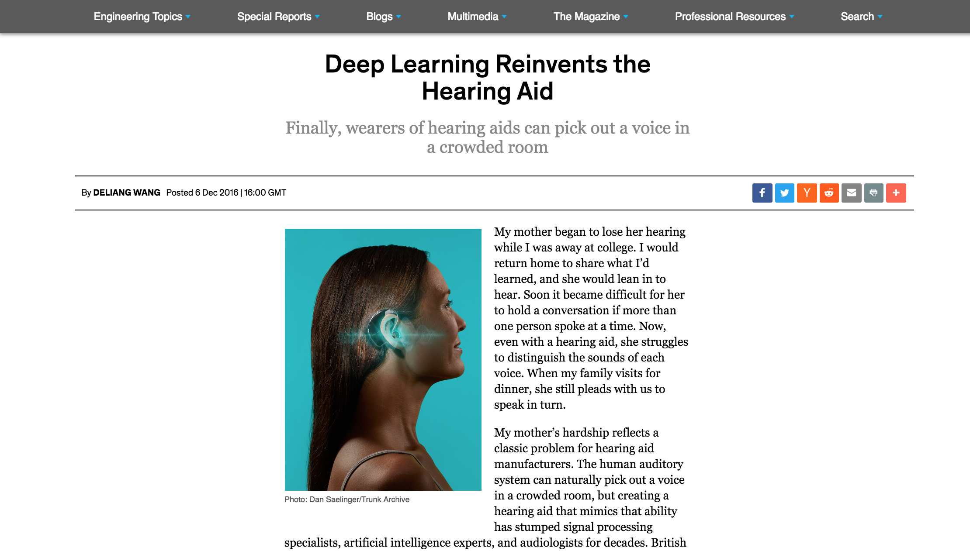
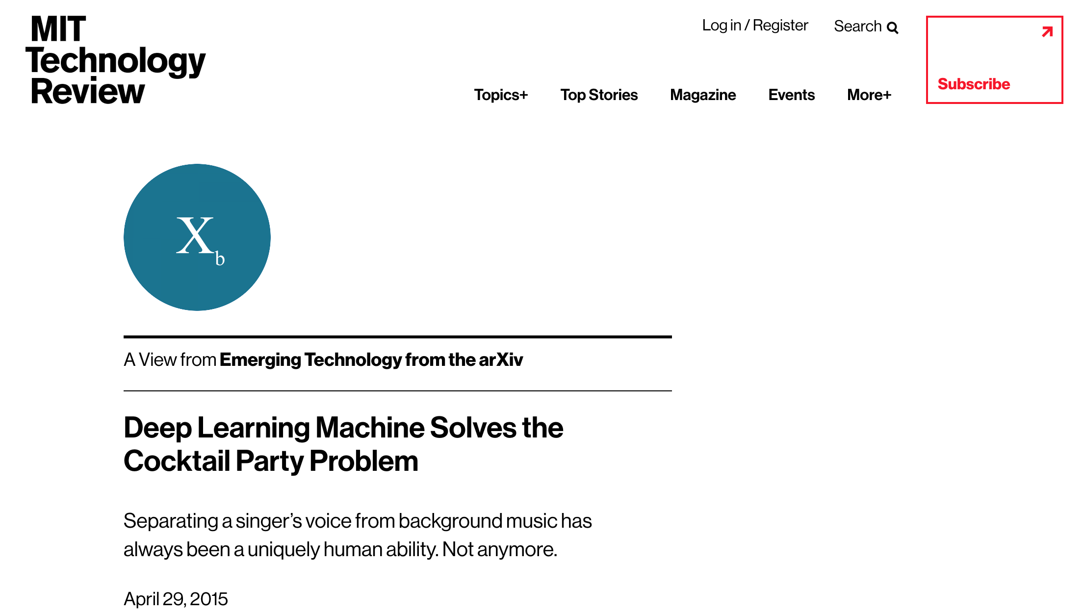
All Of That Said… All Things ML Are Moving At Warp Speed
http://spectrum.ieee.org/consumer-electronics/audiovideo/deep-learning-reinvents-the-hearing-aid

Slide 12
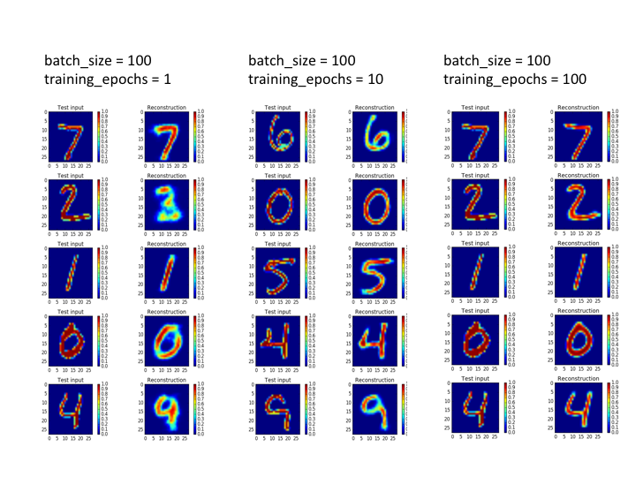
Agenda
What Is Machine Learning?
What Can We Do Today, And What Are The Challenges?
A Brief Look At The State Of “ML for Networking” Industry
Technical explanations/code
https://github.com/davidmeyer/ml
http://www.1-4-5.net/~dmm/ml

Slide 13
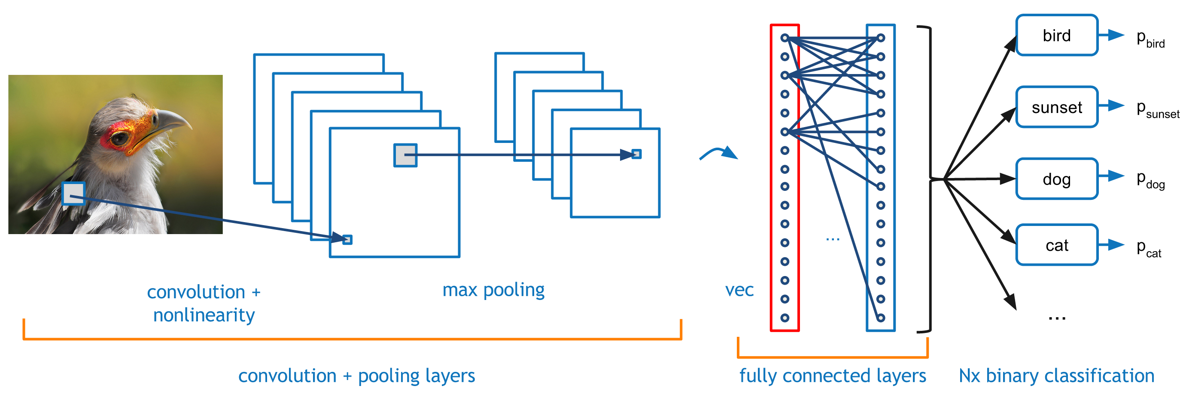
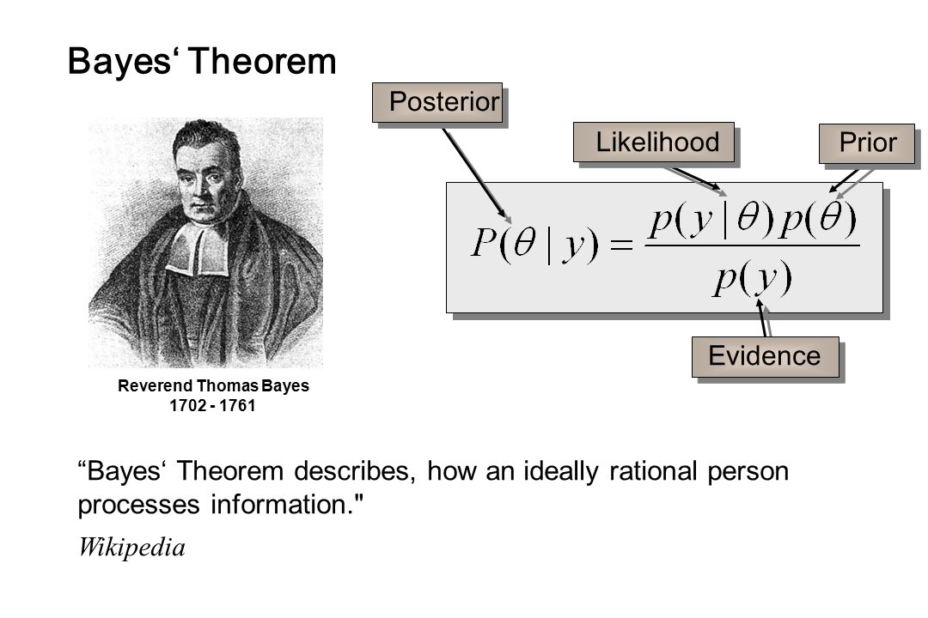
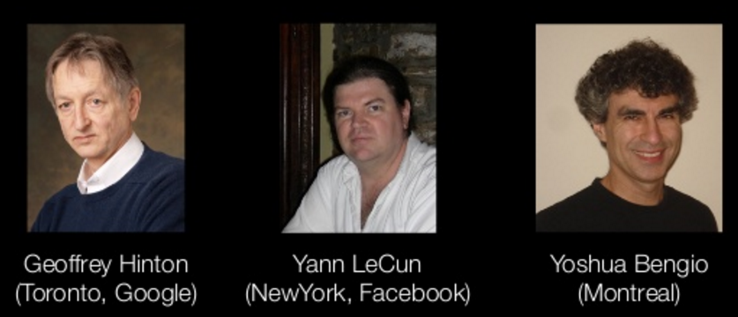
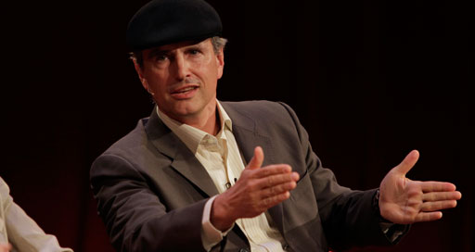
First, Where Have All The Successes Been?
Perceptual Tasks
Vision
NLP
Robotics
New Domains (e.g., market2vec)
Conv Nets
Recurrent Neural Nets
Memory Nets
Two Player Games (GANs, AEs, RL)
Network and Algorithm Design
Statistical Approaches
Some Anomaly Detection
What has driven all of this progress?
Theoretical breakthroughs in 2006
Compute
Data
Talent pipelines
We have seen relatively little progress in the network space. Why?

Slide 14
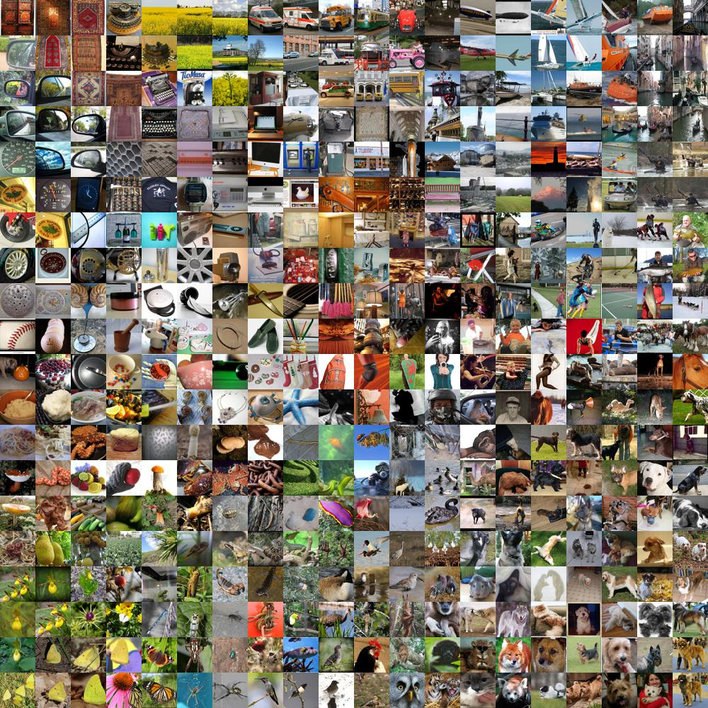
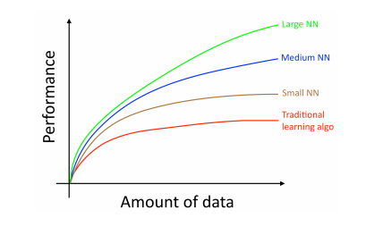
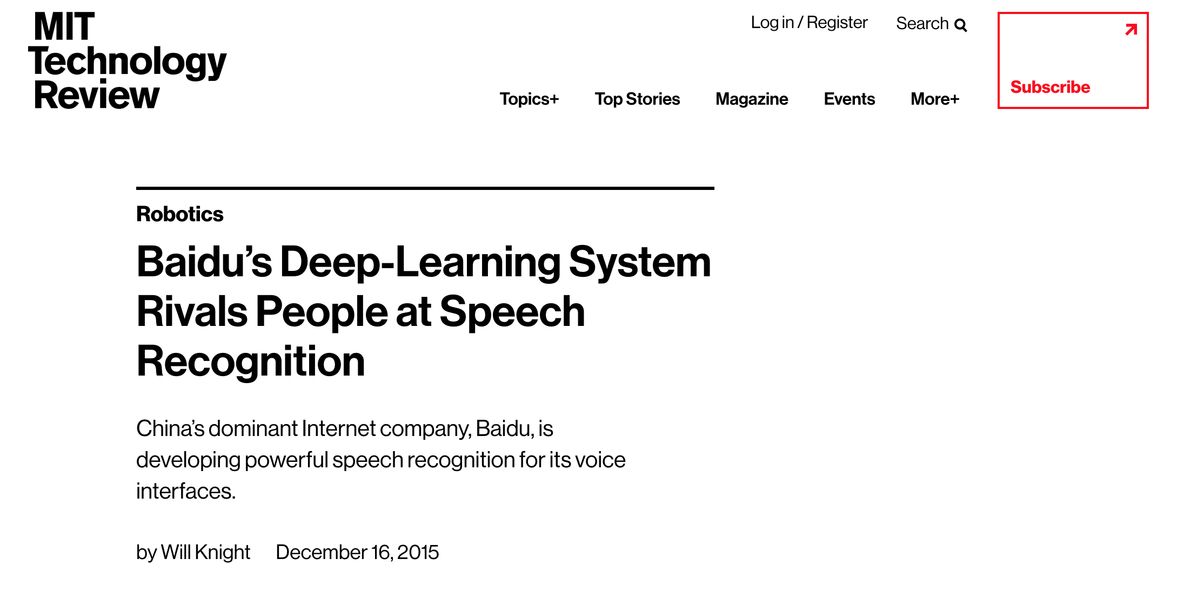
Data
Standardized data sets have been a crucial factor in the success of ML
http://yann.lecun.com/exdb/mnist/
http://image-net.org/
http://allenai.org/data.html
…
Data is the rocket fuel of Machine Learning – Andrew Ng
Allows for direct comparison of learning and inference algorithms
The result has been the steady ratcheting down of error rates on perceptual tasks to super-human levels
Object/Scene recognition
NLP/Voice recognition and generation
AlphaGo
...
We have nothing like this for networking
Many/most data sets are toy, noisy, incomplete, unnormalized, …
Many data sets are proprietary
Much data non-iid
Most of our data sources (e.g., netflow) are representations of network data that were not built for ML
→ Effective ML systems that rely on network data will require novel approaches
There is no standard way to integrate network data with other data sources like CPU usage, memory, ...
https://docs.google.com/spreadsheets/d/1AQvZ7-Kg0lSZtG1wlgbIsrm90HaTZrJGQMz-uKRRlFw
Graph courtesy Andrew Ng

Slide 15
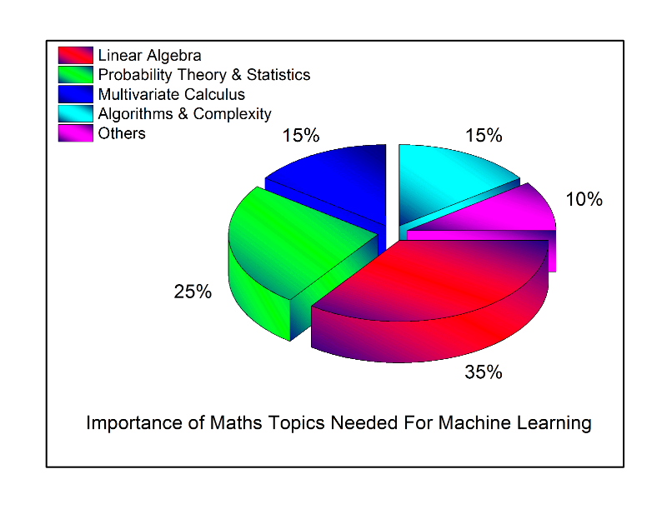
Talent Pipelines
ML is a form of Applied Mathematics
Moreover, ML is a multi-disciplinary empirical science
Network engineers (us!) typically don’t have backgrounds that include the kinds of mathematical training and experience that are essential in the ML space
Effective ML requires additional skills
Ability to rapidly learn new concepts
Data modeling and evaluation
Communications
Software engineering and system design
ML algorithms and libraries
…
The result is that there is a serious skills gap
Open source frameworks are easing this problem
However, deploying ML at scale still requires intimate understanding of the mathematics
But watch out: https://openreview.net/pdf?id=r1Ue8Hcxg, https://www.automaticstatistician.com, http://papers.nips.cc/paper/6461-learning-to-learn-by-gradient-descent-by-gradient-descent.pdf, …
Further, most ML {under}graduates train on perceptual tasks

Slide 16
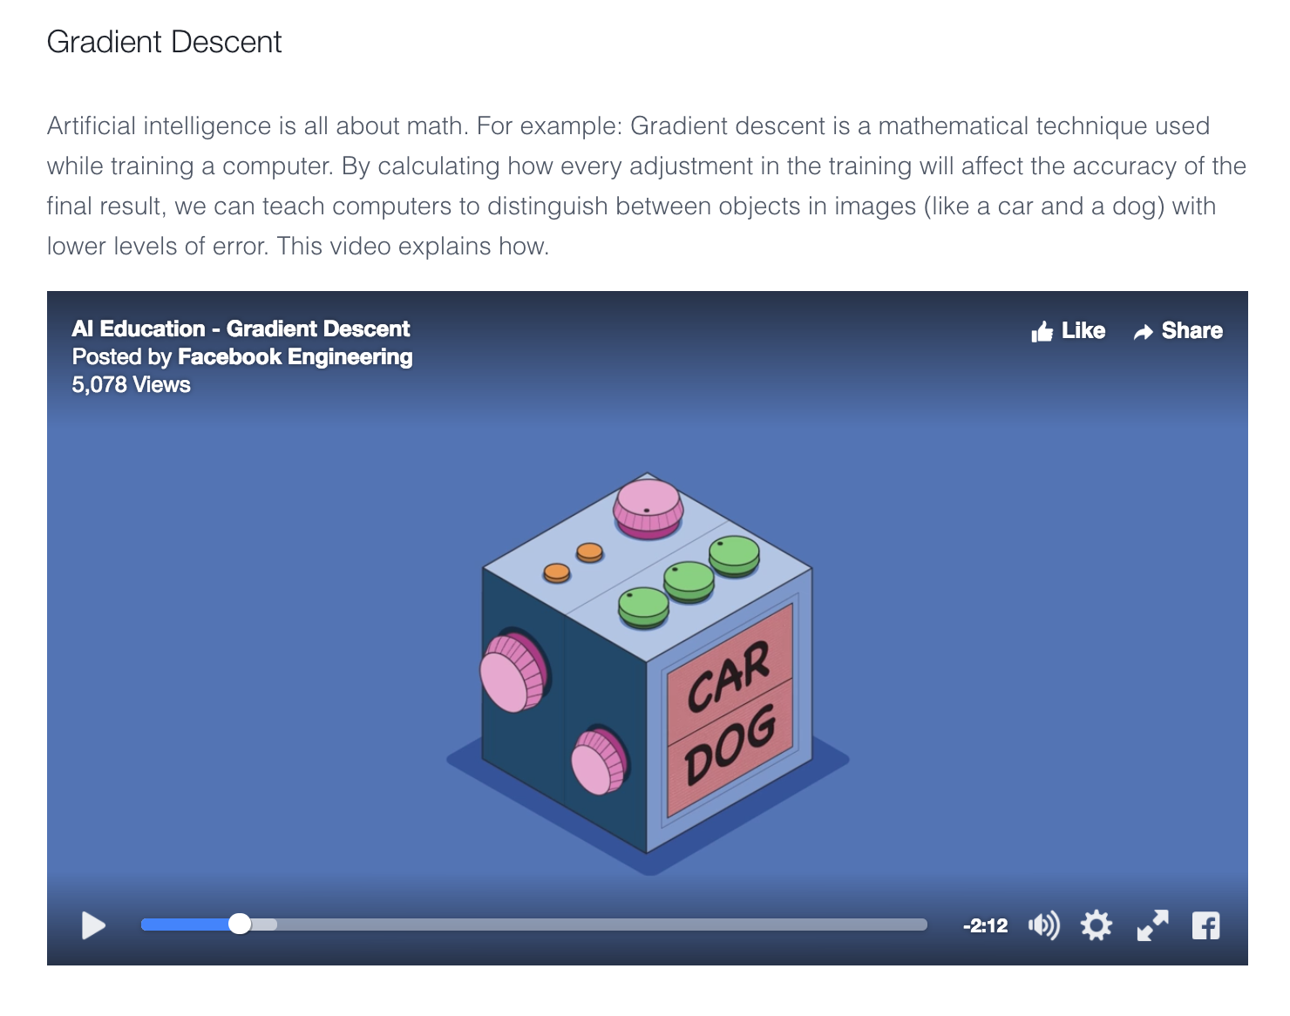
Said Another Way Artificial intelligence is all about math https://code.facebook.com/pages/1902086376686983

Slide 17
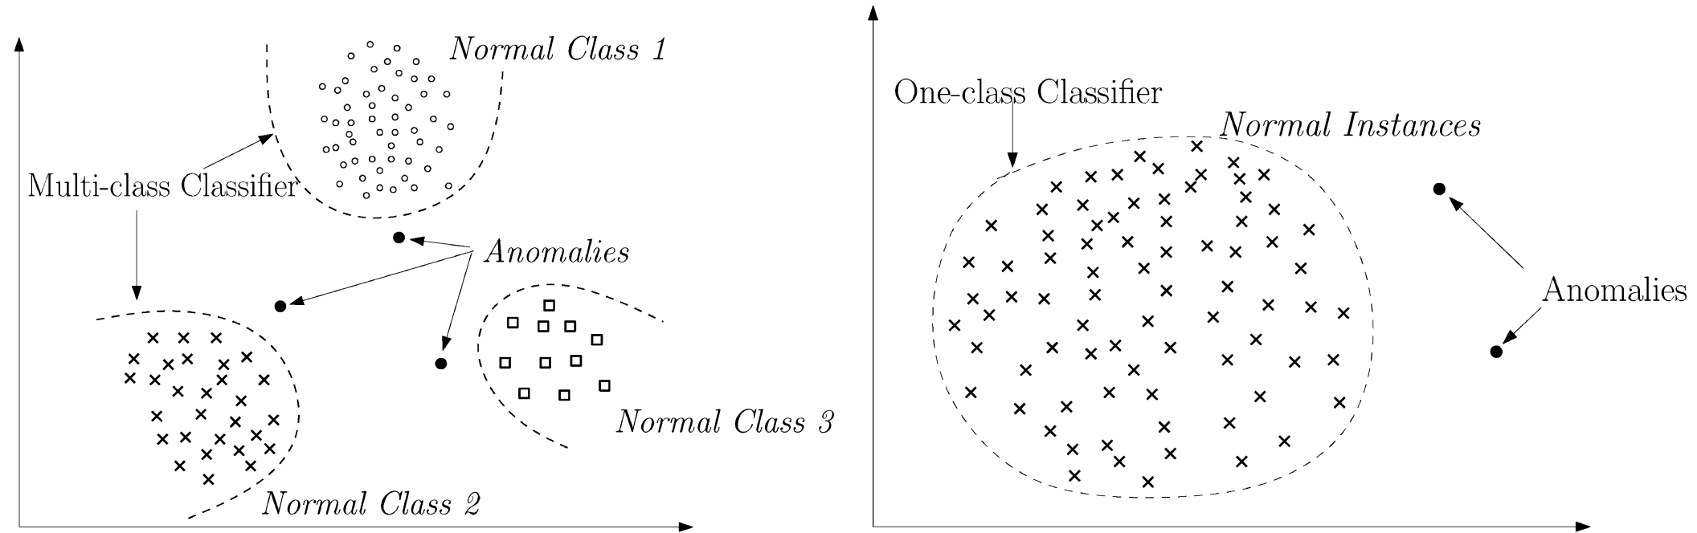
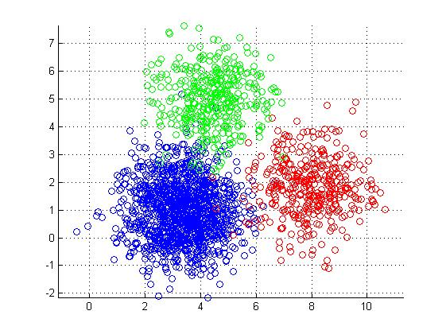
Anomaly Detection and Classification
Approach
Construct nominal model (aka baseline)
Assume that data that are far from the baseline are generated by a different process (anomalies)
Evaluation of far usually requires a hyper-parameter
Clustering
- K-means
- K-NN
- …
PCA
Autoencoders
….
Dimensionality
Reduction
Lots of ways to do this
Original slide courtesy Armin Wasicek
Notes:
1. A = { x | s(x) > t }
2. f(A) → e ∧ min_{e}( False Positives , …)

Slide 18
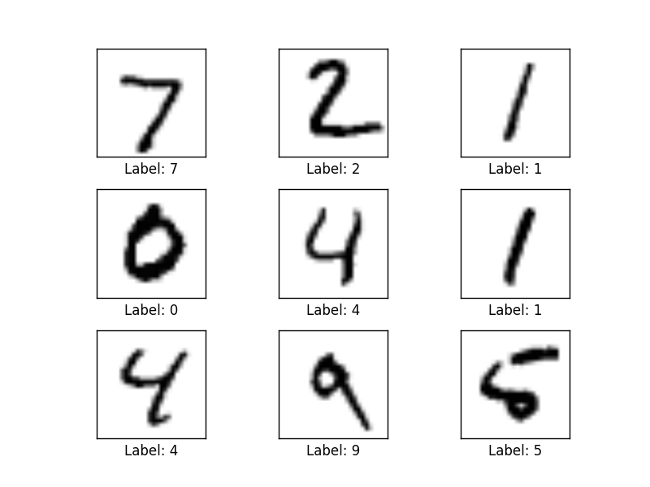
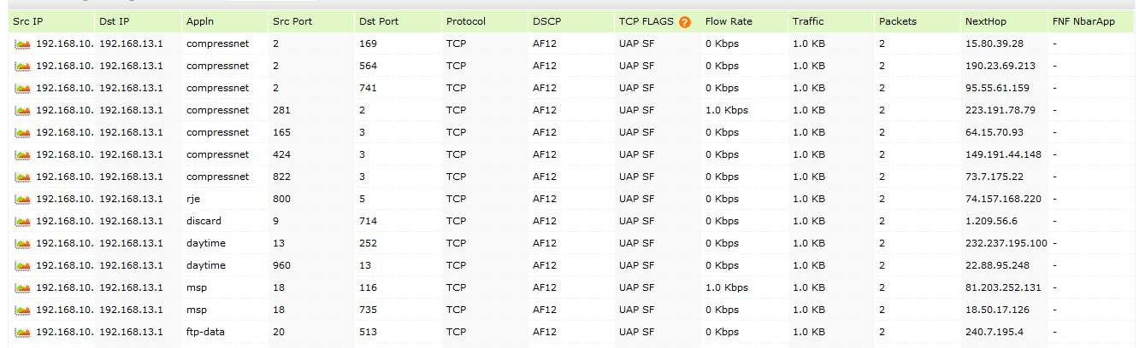
Autoencoder Example Detecting Anomalies in Handwritten Digits
MNIST: 28x28 Grayscale Handwritten Digit Dataset
Training set: 55000 images
Test set: 10000 images
Validation set: 5000 images
Features here are pixels (28x28 = 784)
I’m using MNIST here because you can easily visualize what is going on. In our case, instead of the input being vectors of {0,1} we will have vectors of counters of various features s/a bandwidth, and other network and host based metrics/KPIs.
We can analyze network/system data in the same way
Features here are
various counters
andother KPIs

Slide 19
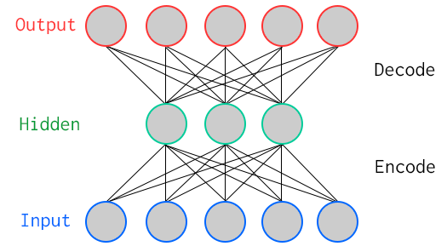
One Way To Learn To Recognize MNIST: Use An Autoencoder Special Kind of Neural Network
784
Artificial Neurons
100
Artificial Neurons
784
Key Characteristic: Hidden layer has fewer units than input/output → Compression
Goal: Minimize reconstruction (decode) error
How to define error (loss, cost)?
Binary classification: Threshold reconstruction error → normal/abnormal
Unsupervised learning

Slide 20
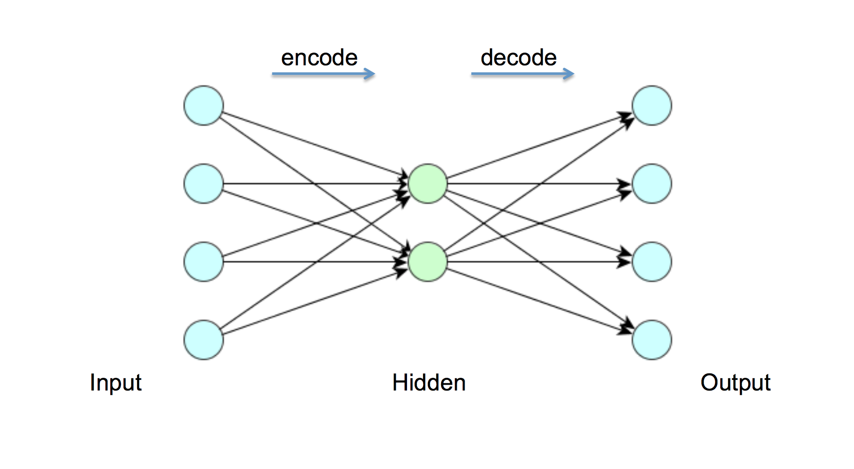
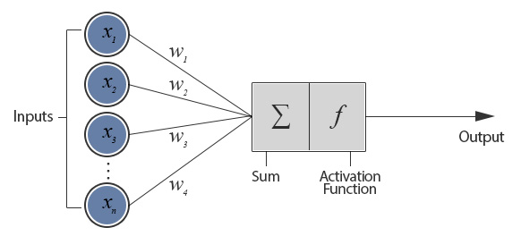
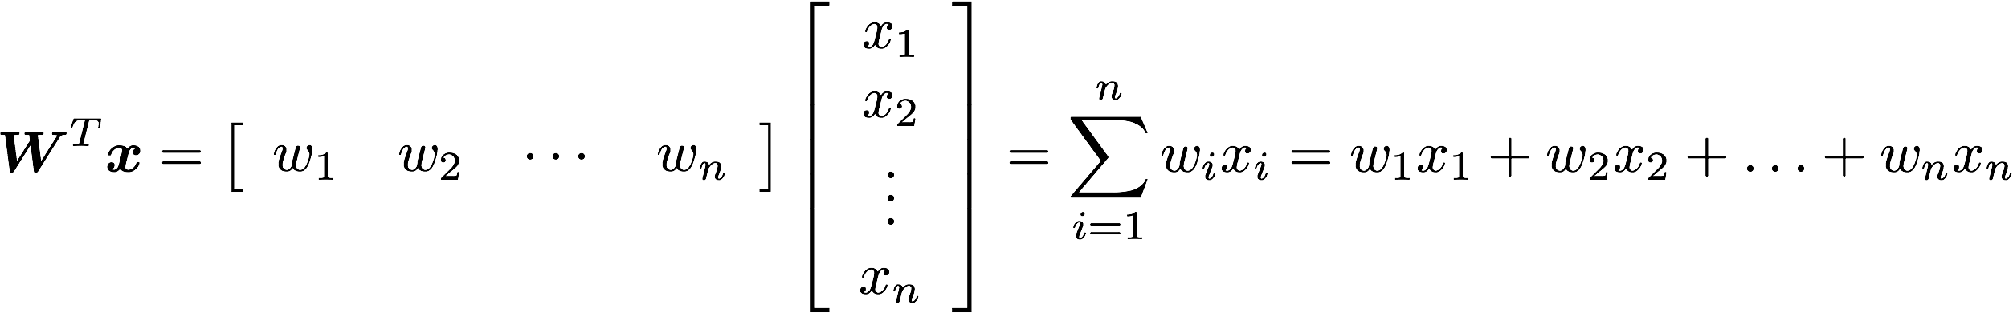
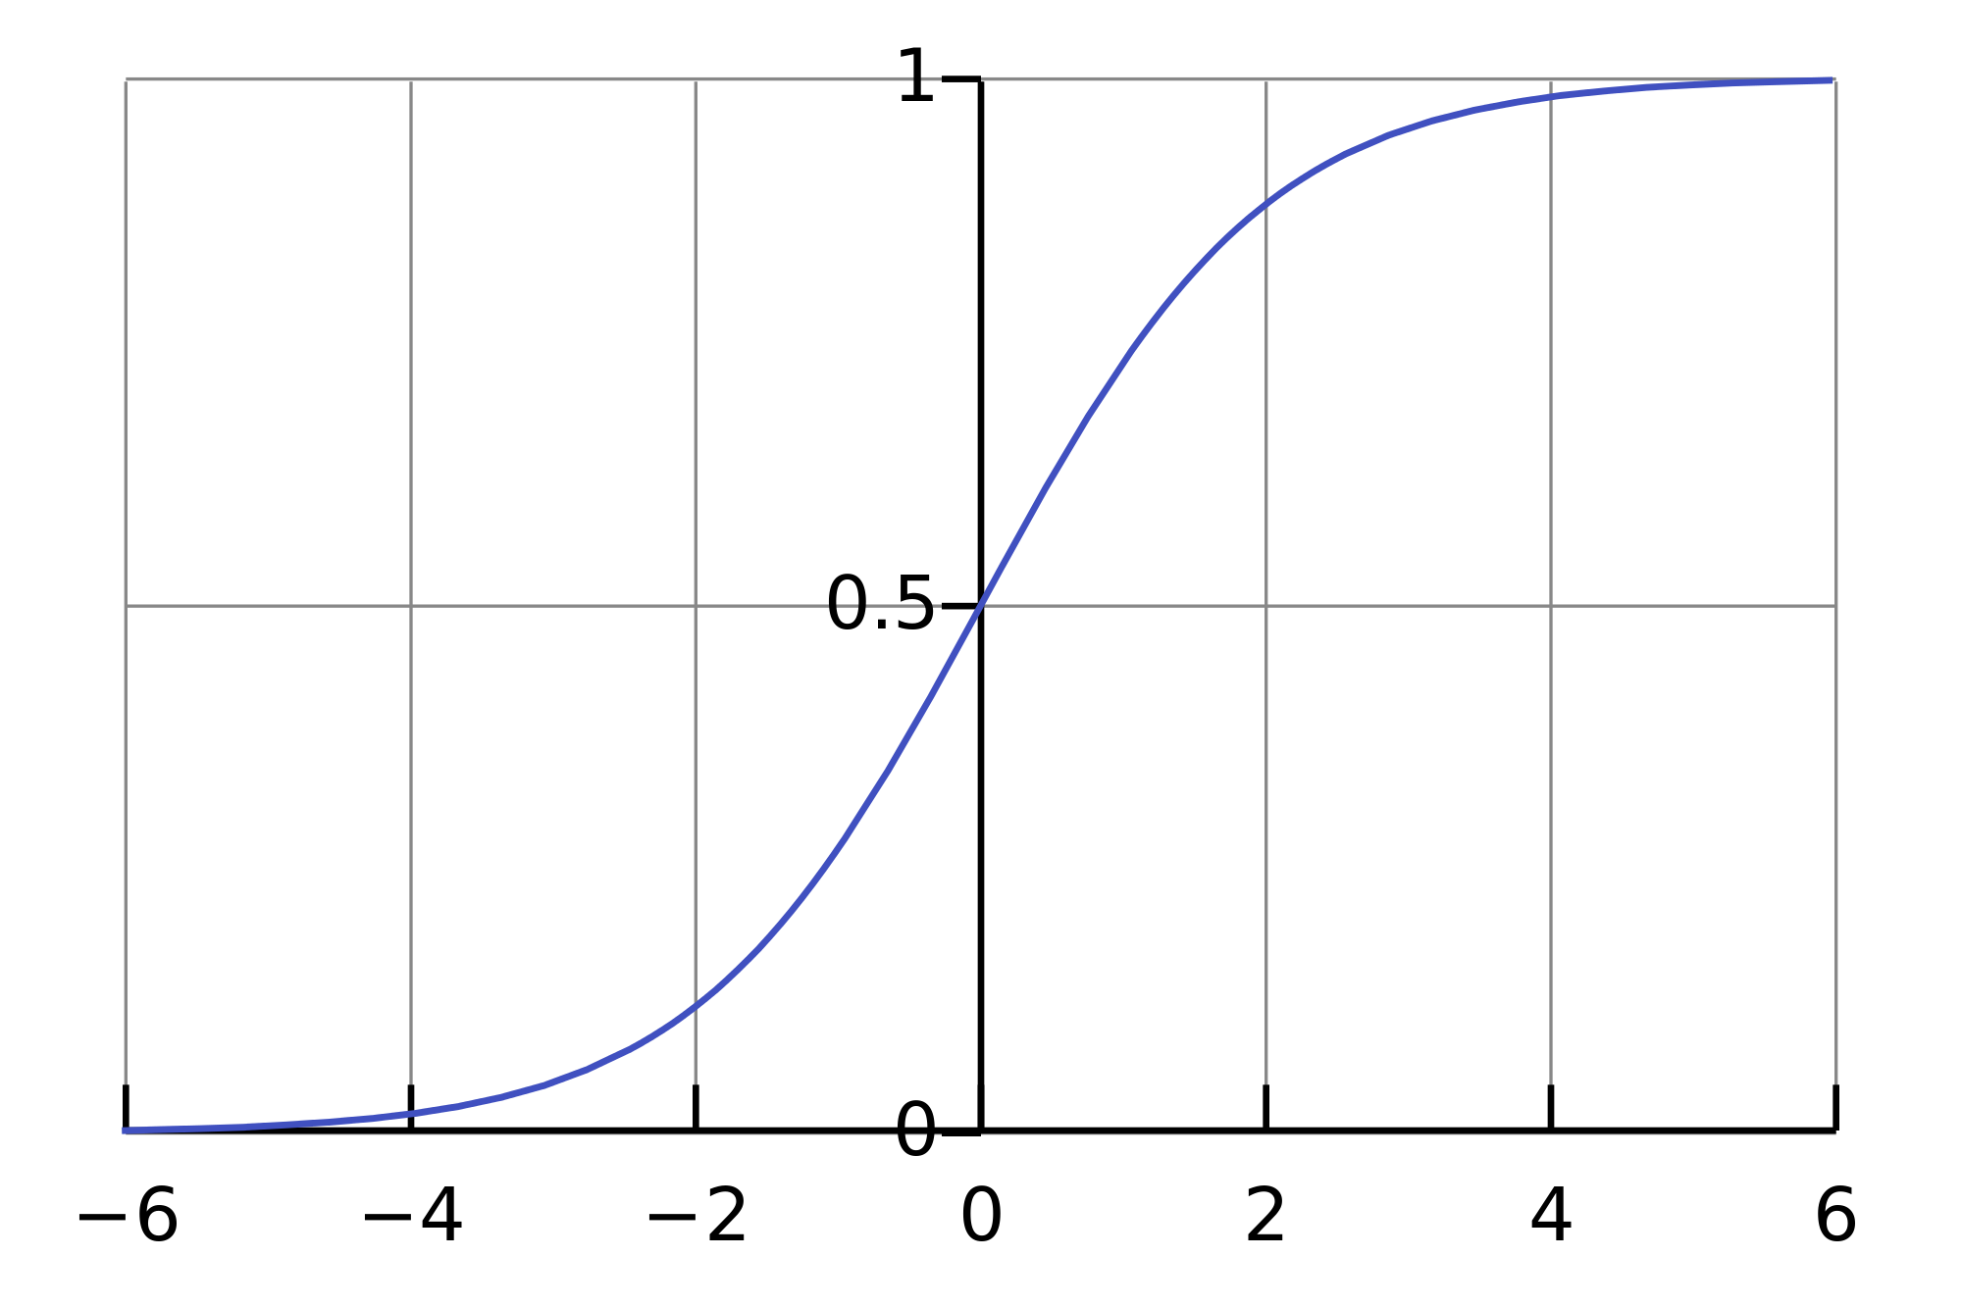
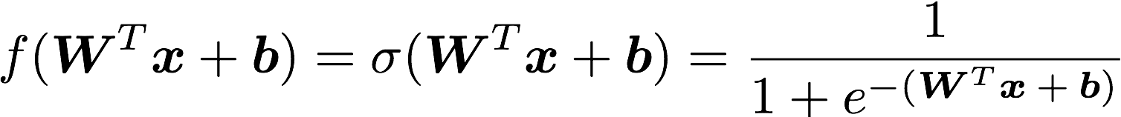
But First: What Does A Single Neuron Do?
Inner (dot) Product
784
100
784
BTW, how many parameters?
784x100 + 100x784 = 156800

Slide 21
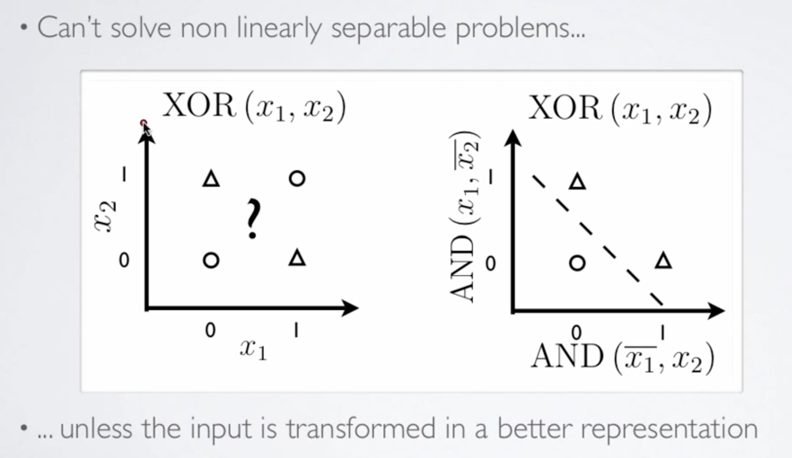
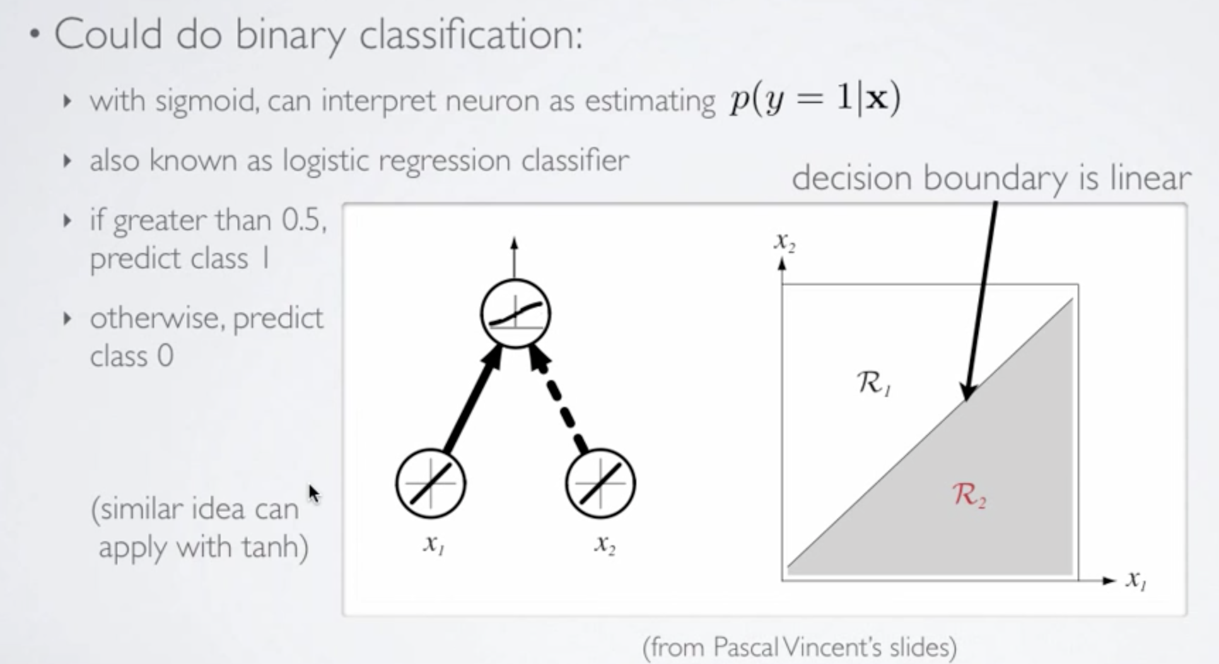
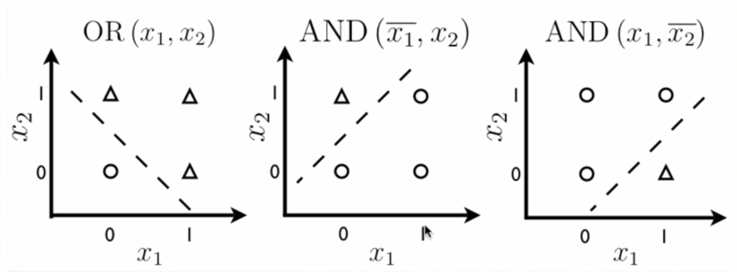
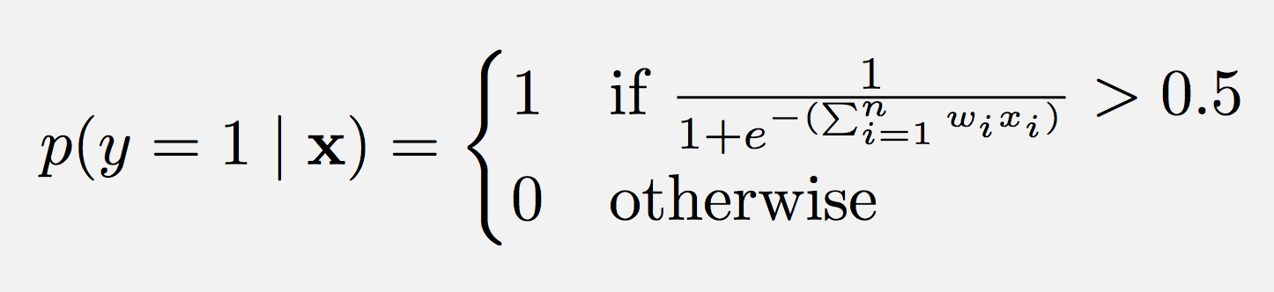
So What Kinds of Things Can a Single Artificial Neuron Compute?
Can Solve Linearly Separable Problems
Graphic courtesy Hugo Larochelle

Slide 22
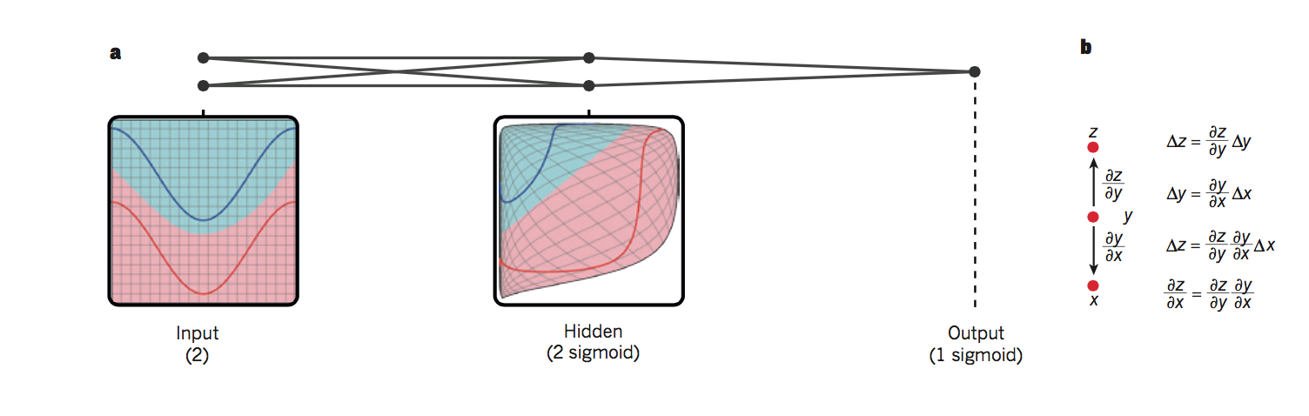
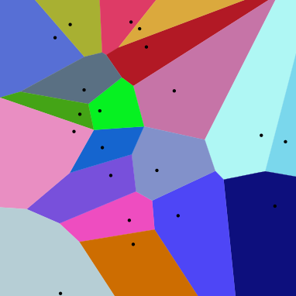
So What is Really Happening Here?
Linear Decision Boundary
Target function represented by input data is some twisted up manifold
Deep Nets disentangle the underlying explanatory factors in the data so as to make them linearly separable
Graphic courtesy Christopher Olah
Voronoi diagram under Euclidian distance
Voronoi diagram under Euclidian distance
Linear Separability in a Neural Network
Linear Separability in a Neural Network

Slide 23
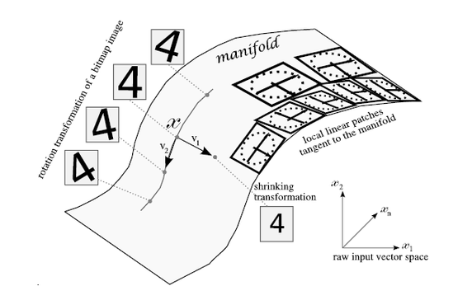
Manifolds?
X is a high dimensional vector (28² = 784)
Data concentrated around a lower dimensional manifold
Hope to find representation R of that manifold
Graphic courtesy http://www.deeplearningbook.org

Slide 24
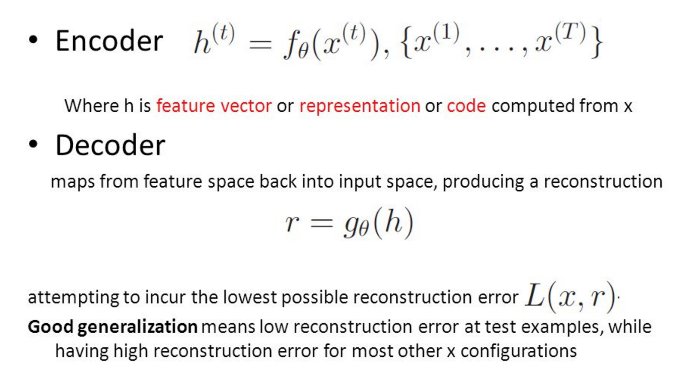
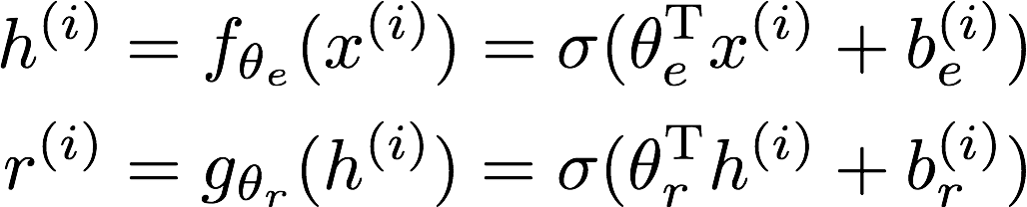
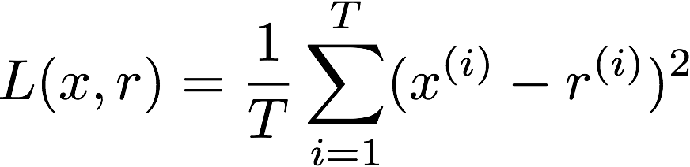
So OK, All Cool, But How Does The Autoencoder Actually Work?

Slide 25
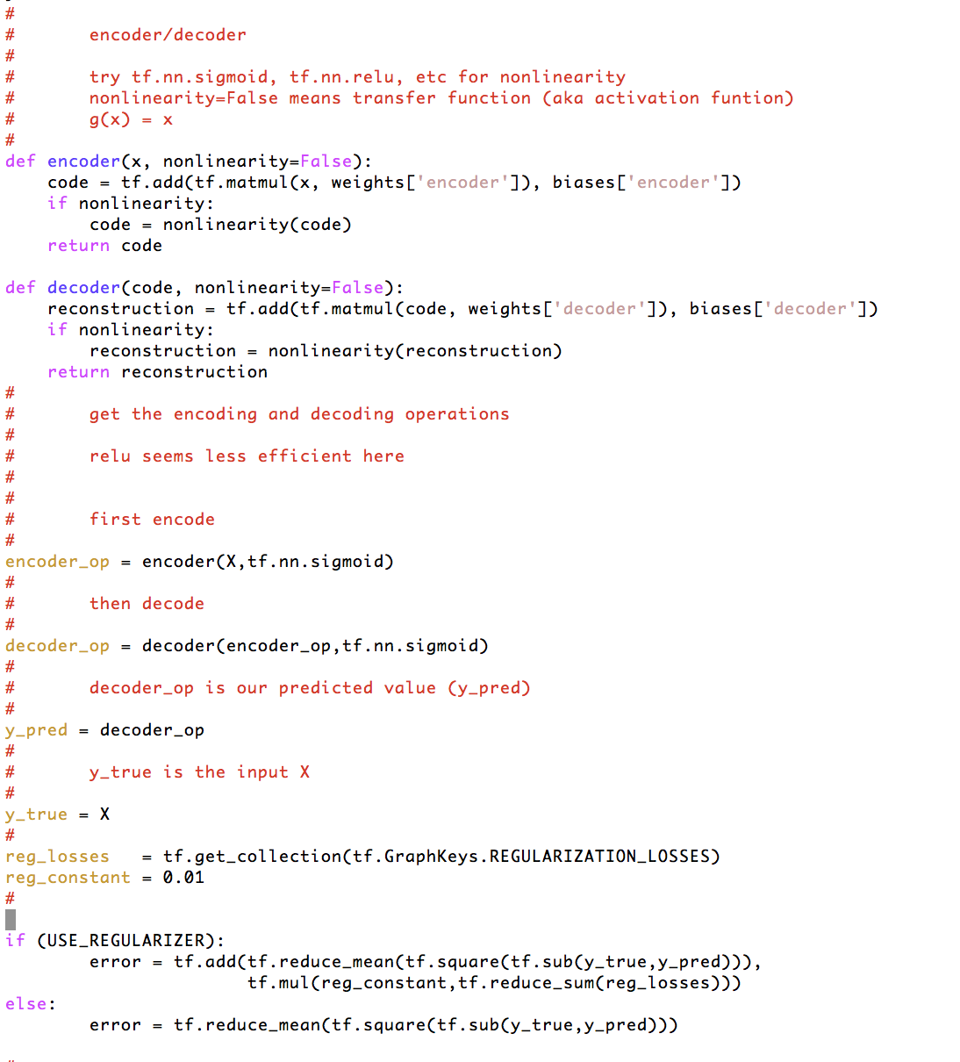

How Hard To Code This Up In Tensorflow?
https://github.com/davidmeyer/ml/blob/master/tensorflow/autoencoder.{py,ipynb}

Slide 26
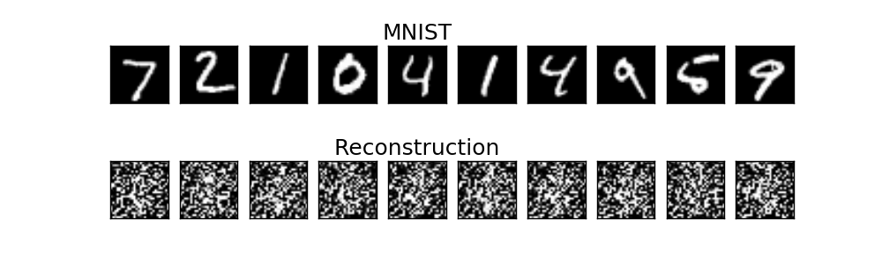
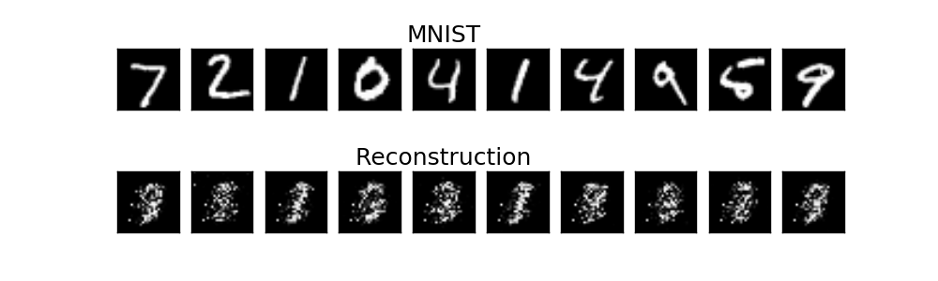
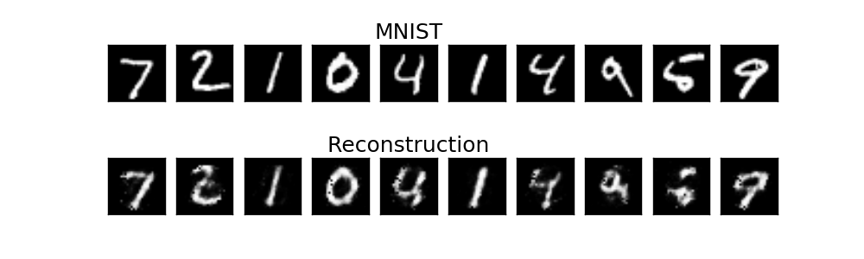
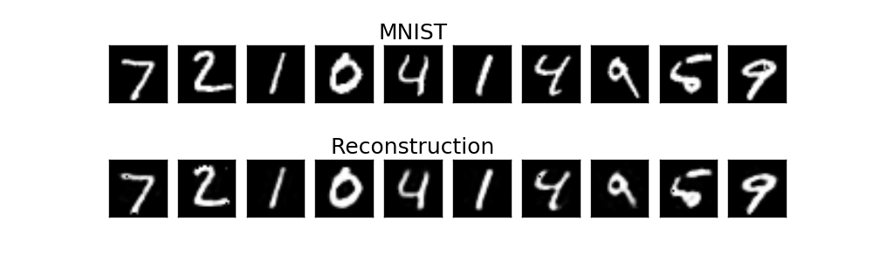
Autoencoder Output
1 example
10 examples
100 examples
1000 examples
After training, the AE gets low reconstruction error on digits from MNIST and high reconstruction error on everything else: It has learned to recognize MNIST

Slide 27
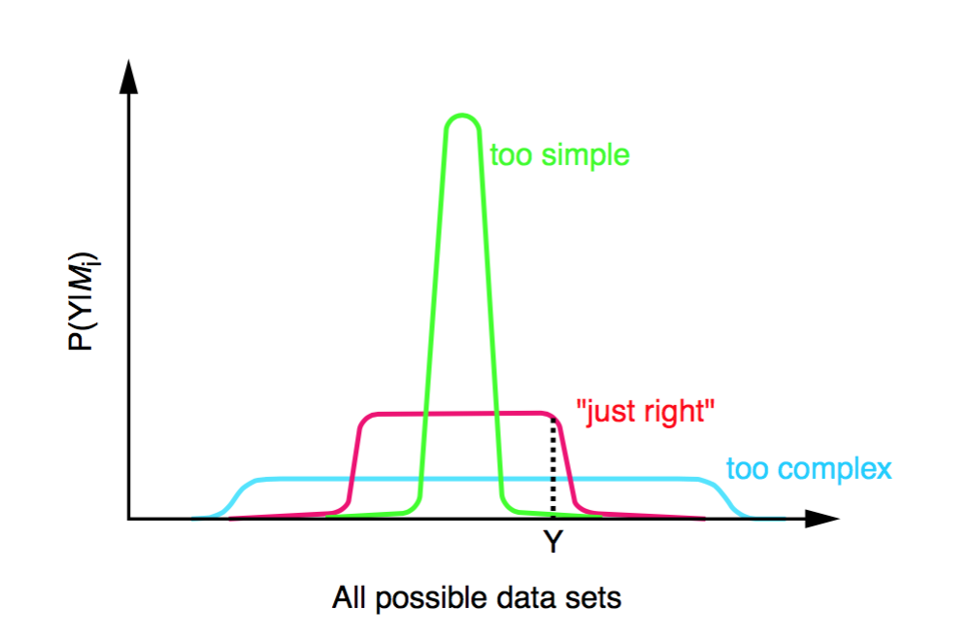
How Much Of This Has Been Applied To Networking?
Not too much. Many reasons:
Community challenges
Lack of understanding about how progress is made in ML, hype, skill sets, proprietary data sets/use-cases,…
Apple
Diverse types of network data
Flows, logs, various KPIs, … with no obvious/consistent way to combine
Incomplete data sets, non-iid data
Network data not designed for ML
Different models for different data types
Still active area of investigation
Occam’s Razor
No useful “Theory of Network”
Consider the problem of object recognition/conv nets
Receptive fields, shared weights, simple and complex cells, ...
Transfer learning

Slide 28
Agenda
What Is Machine Learning?
What Can We Do Today, And What Are The Challenges?
A Brief Look At The State Of “ML for Networking” Industry
Technical explanations/code
https://github.com/davidmeyer/ml
http://www.1-4-5.net/~dmm/ml

Slide 29









First, We’ve Seen All Of This (And More)
But What About Networking?

Slide 30

So What About Networking?
Machine learning is revolutionizing the world as we know it, both in and out of the
digital realms, and is predicted to expand to a $2 trillion market by 2025.

Slide 31

5G Networks

Slide 32

Perhaps More Interestingly
In this paper, we ask if machine learning can provide a viable
alternative to human-generated heuristics for resource management.
In other words: Can systems learn to manage resources on their own?
https://research.microsoft.com/en-us/UM/people/srikanth/data/deeprm_hotnets16.pdf

Slide 33

However…
Slide courtesy Armin Wasicek

Slide 34

And…

Slide 35
So Why The Slow Uptake?
Skill Sets, Data and Community Challenges Dominate
Result:
Most ML systems today use decades old technology
”Unsupervised” Learning
PCA,k-Means, k-NN, other clustering
Dimension Reduction
Various Ad-Hoc Statistical Methods
No usable “theory of network”
Let’s briefly look at one commercial system: Cisco Tetration
http://www.cisco.com/c/en/us/products/data-center-analytics/tetration-analytics/index.html

Slide 36
A Few Editorial Comments
As Craig said, “everything is ML” these days
If you have breakthroughs, you’ll see
Publications, at least on arXiv
Open source implementations
Communities
Systems like Tetration are largely comprised of open source “big data” components (big data platform), ad-hoc statistical (”ML”) technology, some hardware, and a healthy dose of marketing/hype
ML in this context means “data driven”
Quite standard in the industry these days
Watch out for MLwashing
Let’s take a closer look at Tetration

Slide 37

Level Set: Machine Learning Lifecycle
Graphic courtesy http://mbmlbook.com

Slide 38
Tetration vs Brocade Analytics Architecture
 | Tetration | Brocade Analytics Architecture
Goal | Network visibility, behavior analytics | Put smarts in smart networks
Form factor | Appliance for one-touch deployment | Open platform for networking data science
Users | Network admins, operators | Data scientists, network admins, everybody
Sensors | Network + host sensors, 3rd party | Packet Broker (virt+phys), Nagios, [Intel Snap]
Ingest scale | 1M-2M packets / s | Target 4M-8M packets / s
Hardware | Nexus 9*-X, 36 servers | MLXe, taps, 8 servers
Retention | 9-12 month, (160 bytes per packet) | TBD
Analytics engine | Kafka, spark, hdfs, druid | Spark, hdfs, tensorflow (?), impala (?)
Standards | Proprietary | Targeting: NFV ETSI MANO, integrate w. SDN
Applications | Application insight: Whitelist generation Policy impact analysis | DDoS mitigation
Deployment | 3 Cisco DC + customer sites | 1 PSNC
Original slide courtesy Armin Wasicek

Slide 39

Tetration ML Features
http://www.cisco.com/c/en/us/products/data-center-analytics/tetration-analytics/index.html

Slide 40



Tetration platform schematic
Standard open source components
Standard interfaces
Tetration Pipeline

Slide 41
So What Do We Want To Do?
Useful Theory of Networking
As opposed to ad-hoc approaches
Again, consider the success of convolutional neural networks
State of the art machine learning algorithms
ML platform and associated automation
Explainable end-to-end systems
Learn control not just prediction
PSNC Use Cases
Others, e.g., Telstra

Slide 42




Learning Control? Reinforcement Learning Meets Monte Carlo Tree Search and Deep Learning
Hard coded control logic (not learned)
Security: Agent can learn dynamic/evolving behavior of adversary
DevOPs: Agent can learn workflow automation (e.g. Openstack Mistral)
Orchestration: Agent can learn dynamic behavior of VNFs/system
Deep policy net, $π\left(s\right)=a, s∈S, a∈A\left(s\right),$can capture human intuition
http://www.nature.com/nature/journal/v529/n7587/full/nature16961.html

Slide 43


For Example Static vs. Reinforcement Learning Architectures
Today’s Static ML Architectures
ML doesn’t have “agency”
Hard-coded or open loop control
Learns prediction
Doesn’t learn control
Assumes stationary DGD
Largely off-line
Reinforcement Learning Architecture
Agent architecture
Agent learns control/action selection
Adapts to evolving environment
Non-stationary distributions
Network gamification

Slide 44
Summary
Lots of Network Data
Standardized and labeled datasets still scarce
However, most network data sources (e.g., netflow) not designed for ML
Arbitrary data might be over-valued
Lots of open source ML frameworks, Cloud APIs, Examples, …
Google -- Tensorflow (tensorflow.org)
Facebook -- Torch (torch.ch)
Microsoft -- CNTK (https://github.com/Microsoft/CNTK)
Amazon -- MXNET (https://aws.amazon.com/mxnet)
Other popular frameworks
Keras (https://keras.io/)
Theano (https://github.com/Theano)
…
However, networking industry still dominated by MLwashing, platforms, clustering, …
Craig’s note
Cisco Tetration, many others
Skills gap persists and it still requires skill/experience to
Build DNN architectures/models
Find ”good” settings for hyper-parameters
Prevent overfitting
But again, be careful: SOTA LSTMs+RLs are starting to be able to build neural networks
https://openreview.net/pdf?id=r1Ue8Hcxg, http://papers.nips.cc/paper/6461-learning-to-learn-by-gradient-descent-by-gradient-descent.pdf, …
…
All of this said, you will be seeing ML in all facets of networking
And everything else for that matter

Slide 45



Finally…Many Beautiful Mysteries Remain
Back-propagation
Gradient-based optimization with gradients computed by back-propagation
Why is such a simple algorithm so powerful?
New optimizer/optimizee paradigms
AlphaGo
https://deepmind.com/research/alphago
Adversarial Images/Generative Adversarial Nets (GANs)
https://arxiv.org/abs/1412.6572
Learning to learn by gradient descent by gradient descent
https://arxiv.org/abs/1606.04474
Neural Architecture Search With Reinforcement Learning
https://openreview.net/pdf?id=r1Ue8Hcxg
Neural Nets
What are the units (artificial neurons) actually doing?
https://arxiv.org/pdf/1509.06321.pdf
Why does deep and cheap learning work so well?
Physics perspective
http://arxiv.org/pdf/1608.08225v1.pdf
Many others
So how many 28x28 grayscale images are there?
Say there are 8 bits of grayscale → 256⁷⁸⁴ possible images
Our autoencoder had 156800 parameters and 156800/256⁷⁸⁴ $≈0$
So how can a simple autoencoder find the MNIST subspace?

Slide 46
Agenda
What Is Machine Learning?
What Can We Do Today, And What Are The Challenges?
A Brief Look At The State Of “ML for Networking” Industry
Technical explanations/code
https://github.com/davidmeyer/ml
http://www.1-4-5.net/~dmm/ml

Slide 47
Overall Agenda
Current Events In Machine Learning: Challenges, Opportunities and Realities
45 min, dmm
Building Smart Networks for Telcos
30 min, Armin
Break
15 min
Use Cases For Data Center Machine Learning At PSNC
30 min, Armin
How To Implement A Collaborative Machine Learning Platform
25 min, Ed
Break
15 min
Automating Machine Learning
25 min, Armin, Ed
Discussion
25 min, all

Slide 48
Thank you and on to Armin

